Slide 1
Peak Traffic Volume Forecasting
Sun Meng

Slide 2
Task Description
Predicting traffic volume of shop webpages is important for providing a better online shopping experience
Peak Traffic Volume (‘PTV’) forecasting based on the ‘PTV’ for a shop in Taiwan during 2017.
Dataset:
PTV_TTV.csv,promotions.csv,vouchers.csv

Slide 3
Table of Contents
Features
Feature Selection & Regression Model
Data and Preprocessing
Result
Interpretation

Slide 4
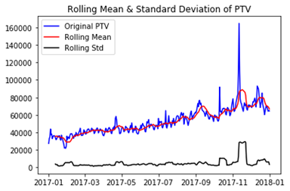
Data and Preprocessing
Table. Dickey-Fuller Test
PTV_TTV.csv
Test Statistic | -2.08
p-value | 0.26
#Lags Used | 6.00
Number of Observations Used | 358.00
Critical Value (1%) | -3.45
Critical Value (5%) | -2.87
Critical Value (10%) | -2.57

Slide 5
Data and Preprocessing
promotions.csv
  Negative discount percent
voucher.csv
  ‘end_time’<’start_time’
  ‘end_time’ after 2018
  Items combination (items with the same ‘start_time’, ’end_time’, ’discount’, ’min_price’, ’value’)

Slide 6
Features
promotions.csv & voucher.csv
  Current day average promotion, voucher policy
  Current day total promotion hours and voucher hours, usage limit

Slide 7
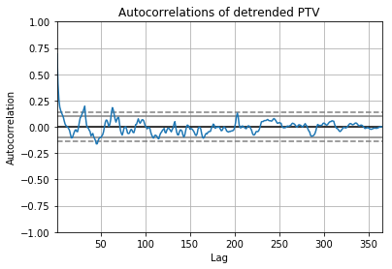
Features
promotions.csv & voucher.csv
  Previous day average promotion, voucher policy
  Previous day total promotion hours and voucher hours, usage limit

Slide 8
Features
PTV_TTV.csv
  ‘data’ and ‘PTV’: ‘date’ and ‘PTV’ in ‘PTV_TTV.csv’
  ‘day’: how many day is the date away from 2017-1-1.
  ‘weekday’: the day of the week of the date
  ‘monthday’: the day of the month of the date
Other factors
  Holidays: All public holidays
  Sale season: 11.11 and 12.12
  delivery stop: Chinese new year

Slide 9
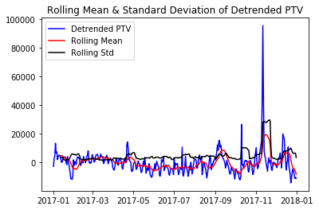
Feature Selection & Regression Model
Estimating and eliminating trend
Table. Dickey-Fuller Test
Test Statistic | -7.13
p-value | 3.46e-10
#Lags Used | 2.00
Number of Observations Used | 360.00
Critical Value (1%) | -3.45
Critical Value (5%) | -2.87
Critical Value (10%) | -2.57

Slide 10
Feature Selection & Regression Model
10-fold cross validation.
Select regression model.
  Extra-Tree Regressor, Polynomial Regressor

Slide 11
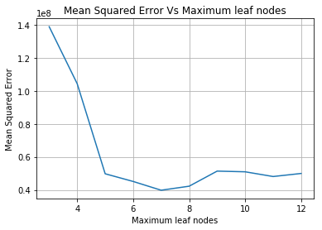
Feature Selection & Regression Model
Select parameters
  Extra-Tree Regressor: ‘max_leaf_nodes’=7, Polynomial Regressor: ‘degree’=2

Slide 12
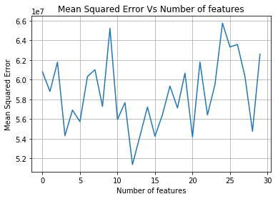
Feature Selection & Regression Model
Feature Selection
  Extra-Tree Regressor: 12 best features
  Polynomial Regressor: 2 best features

Slide 13
Result
Prediction Model
  Linear Regressor, the input is ‘day’.
  Extra-Tree Regressor, parameter setting is ‘max_leaf_nodes’=7, input is ['event_l', 'event', 'promotion_item', 'weekday' , 'voucher_min_n', 'monthday', 'promotion_hour', 'voucher_number', 'voucher_value_n' , 'voucher_discount_l', 'voucher_number_l', 'voucher_total_l']
  Polynomial Regressor, parameter setting is ‘degree=2’, input is ['event', 'promotion_item']

Slide 14
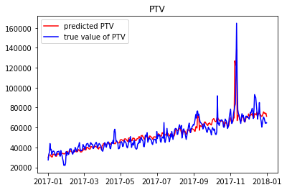
Result

Slide 15
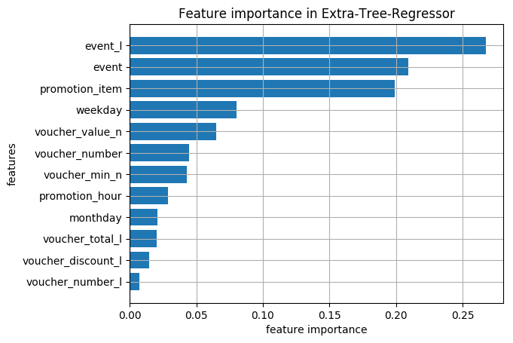
Interpretation
Steady increase in PTV with the time.
‘event’ (public holidays, sale seasons, etc.) is the most important factor.
The number of promoted items and the number of vouchers influence PTV much more than the discount or refund offered by promotion and vouchers.

Slide 16
THANKS!
Q & A

